Slide 1
DSIF5 Capstone Project Horse Race Prediction
Ethan Lee
22 Oct 2022

Slide 2
Agenda
Problem Statement
Gathering and Cleaning Data
EDA
Modelling
Models Used (Classification and Regression)
Evaluation Metrics
Feature Importance and SHAP
Backtesting
Deployment

Slide 3

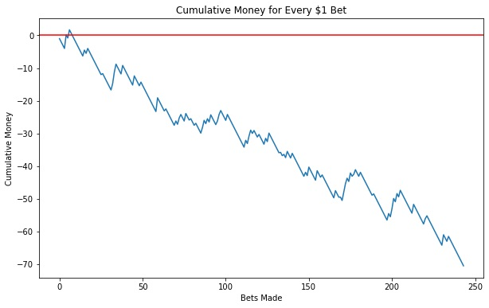
Problem Statement
Inspired from the Bloomberg article in 2018 “The Gambler who Cracked the Horse-Racing code”
Bill Benter has made a billion dollars from horse betting
At its peak, his model factored in over 120 variables per horse, and earned an estimated $100m per season
Can we use machine learning models to predict horse race results and profit from them?
Consider the base case of betting on the horse with the lowest odds at every race
After 240 races and placing $1 each time, we will still be making a net loss of $70

Slide 4
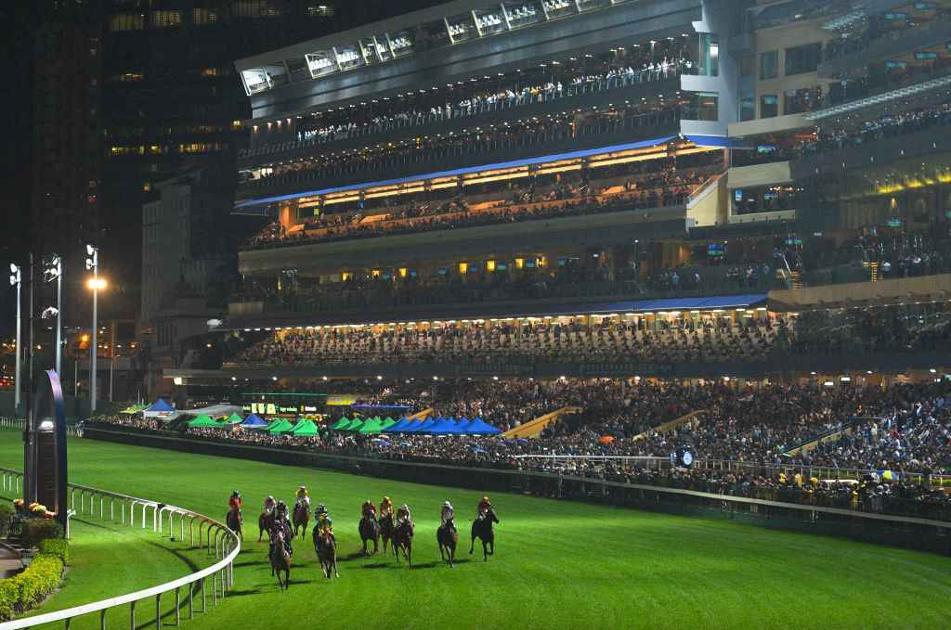
Background
Dataset was obtained from Kaggle, courtesy of the Hong Kong Jockey Club
Hong Kong horse racing is the most popular spectator sport in the city
Happy Valley and Sha Tin welcomes more than 2.2m people in a season.
Total bets turnover for a weekend race can reach HK$1.5bn (~US$200m)
You can bet on racing most weeks of the year (Wednesdays at Happy Valley, Saturdays and Sundays at Sha Tin)

Slide 5
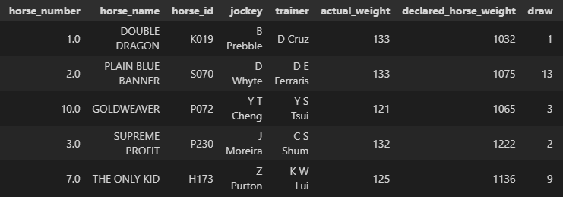
Data Processing
Dataset has >20 variables on the details of the race
Contains more than 2000 races throughout the 2014-2017 racing seasons (~30,000 rows)
Columns | Description
Finishing Position | Rank of the horse at race end
Horse Number | Number of horse in a specific race
Horse Name | English name of the horse
Jockey | The person who rides the horse (A jockey can ride different horses in different races)
Trainer | The one who trains the horse (A trainer can train multiple horses)
Actual weight | Extra weights carried by the horse to make the race more competitive
Declared horse weight | Weight of the horse on date of race
Draw | Starting position of the horse. Inner positions (smaller numbers) are usually advantageous.
Win odds | The multiplier on how much you will receive if you win the bet

Slide 6




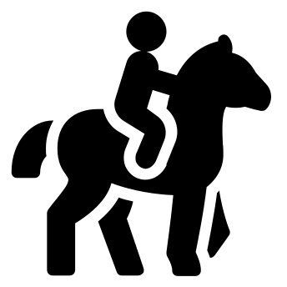
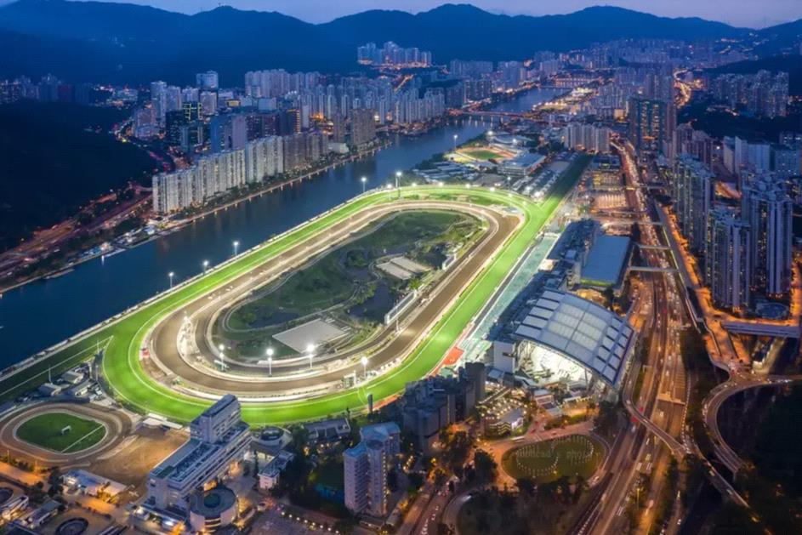




What are some factors affecting a race outcome?
Recent form of the Horse/Jockey
Weather/
Temperature
Weight of the Horse
Weight of the Jockey
Draw number
Handicap Weights
Condition of the ground
Quality of Trainer
Crowd at the horse track?
Distance of the race

Slide 7
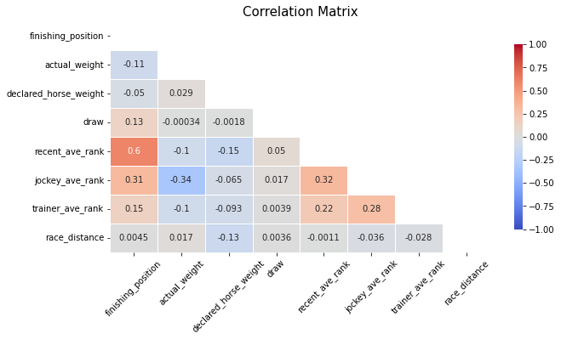
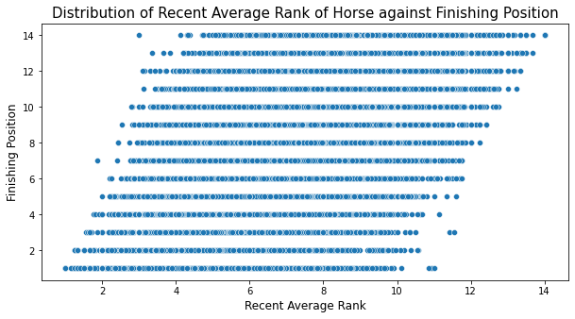
Feature Engineering
Create 3 more new variables to take into account the recent form of the horse, the jockey and the trainer
There is a high correlation between recent performance and the outcome of a race
Horse Name | Race |  |  |  | Finishing Position | Recent Positions
SO FAST | Race 1 |  |  |  | 1 | NA
SO FAST | Race 2 |  |  |  | 2 | 1
SO FAST | Race 3 |  |  |  | 3 | 1/2
SO FAST | Race 4 |  |  |  | 4 | 1/2/3
Recent Avg Rank
NA
1.0
1.5
2.0
Mean of recent performances

Slide 8
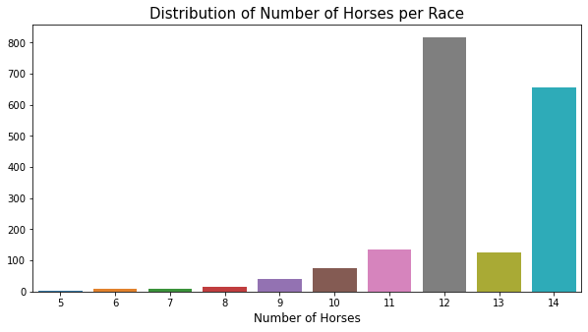
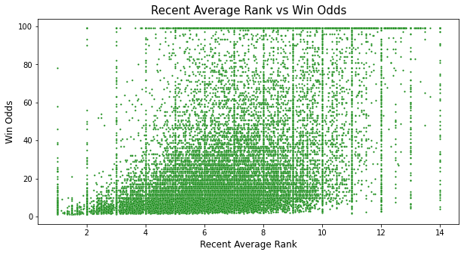
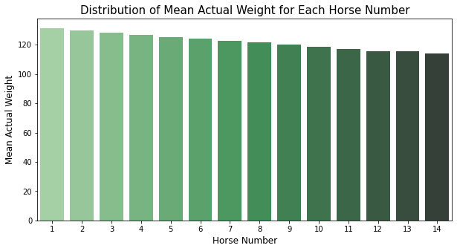
EDA – Primer into HK Horse Racing
Most common to have 12 or 14 horses per race
Lower odds are given for better performing horses
Races follow a handicap system. Horses with better recent performances are given a smaller horse number and additional weights to carry to make races more competitive.

Slide 9
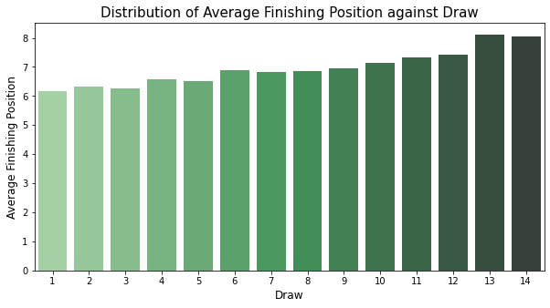
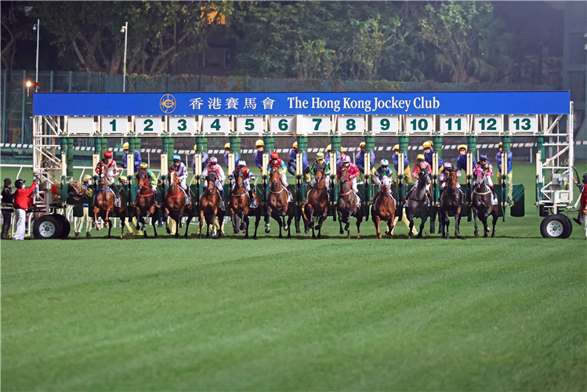
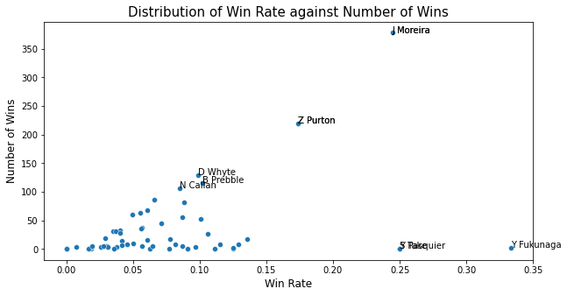
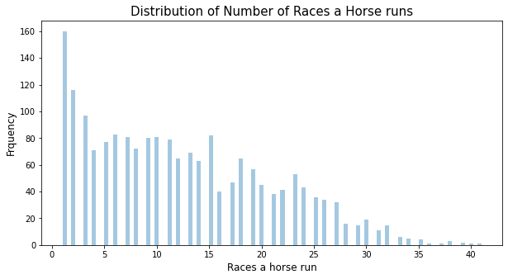
EDA – Primer into HK Horse Racing
Draws refer to the starting position and smaller numbers are advantageous as they correspond to the inner lanes.
Race horses start racing at 2-3 years old and generally have a short career lifespan (less than 3 years).
Jockeys have longer careers. Two of the most successful jockeys shown here are Joao Moreira and Zac Purton.

Slide 10
Modelling - Overview
Outcomes:
We want to predict horses that will finish in First place, and also in the Top 3 places
We want to predict which horse finishes the race in the fastest time
Train-test-split
Train Set
Hyperparameter Tuning
Fit the model
Classification
F1 Score
PR-AUC Score
True Positive Rate
Regression
RMSE
Generalization
Accuracy of predictions
Test Set
Evaluate metrics
Backtesting
Get Predictions

Slide 11
Modelling – Getting X and y
Handicap Weight | Horse Weight | Draw Number | Jockey Rank | Trainer Rank | Horse Rank | Race Distance | HorseWin | HorseTime
126 | 1124 | 9 | 6.43 | 6.71 | 2.75 | 1400 | 1 | 69.5558
123 | 1175 | 7 | 6.49 | 6.9 | 5.09 | 1400 | 0 | 71.1058
132 | 1137 | 3 | 7.16 | 6.68 | 6.12 | 1400 | 0 | 70.9723
124 | 1108 | 11 | 6.15 | 6.83 | 5.33 | 1200 | 1 | 60.3245
7 Features used as variables for X:
Handicap Weight
Horse Weight
Draw Number
Jockey Average Rank
Trainer Average Rank
Horse Average Rank
Race Distance
y targets to predict:
Whether horse will win first place
Classification
Regression
How long does the horse takes to complete the race?

Slide 12
Modelling – Train Test Split
As dataset is in chronological order, we will slice out the last 10% for backtesting.
Following that, we will do a 80-20 split between Train and Test, cutting off at a particular race in the 80th percentile from the non-backtesting slice
To do hyperparameter tuning of models
To fit on models
Train Set
E.g. Race 1 to 64
Test Set
To evaluate metrics
To check predictions and compare
E.g. Race 65 to 89
Unseen Set
Pretend that this is real world unseen data
Only to be used for backtesting
E.g. Race 90 to 100

Slide 13
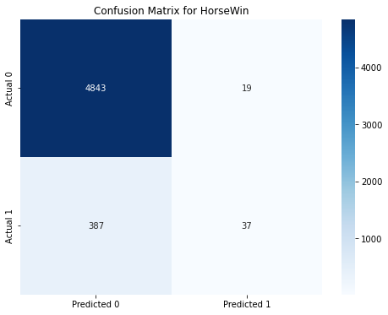
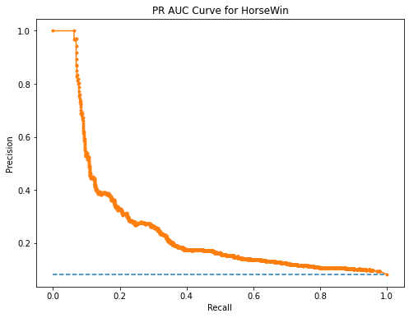
Modelling – Classification
Metrics used to evaluate the imbalanced class (Top horse or Top3 horses):
Recall/Sensitivity: TP/(TP+FN), also known as True Positive Rate
Precision: TP/(TP+FP), it can be interpreted as the percentage of bets we made correctly
PR-AUC: Area under the Precision-Recall curve, the higher the better
F1 Score: Harmonic mean of precision and recall, the higher the better
TN
FP
FN
TP
Model | CV Score | F1 Score | PR-AUC | Recall | Precision
Log Regression | 0.891 | 0.891 | 0.113 | 0.050 | 0.750
Gaussian NB | 0.892 | 0.889 | 0.121 | 0.146 | 0.395
RandomForest | 0.899 | 0.895 | 0.131 | 0.090 | 0.632
SMOTE + RF | 0.883 | 0.715 | 0.107 | 0.597 | 0.124
We chose the Random Forest model as it had the best F1 and PR-AUC score. We also sacrificed Recall for Precision as we wanted to increase our bet win rate.

Slide 14
Modelling – Regression
Metrics used to evaluate the regression model
Root Mean Squared Error: RMSE, the lower the better
Generalization Error: We try to minimize the RMSE between the train and test set
Accuracy of prediction (Precision): Based on timing predictions, we find the fastest horse (or Top 3 horses) for each race and check against the actual race results
Model | Train RMSE | Test RMSE | Generalization Error (%) | Top1 Accuracy | Top3 Accuracy
Ridge | 2.425 | 2.482 | 2.351 | 0.245 | 0.403
KNN Regressor | 6.171 | 6.666 | 8.021 | 0.132 | 0.304
RandomForest | 1.991 | 2.056 | 3.161 | 0.224 | 0.391
LGBM Regressor | 2.518 | 2.573 | 2.181 | 0.285 | 0.489
We choose the LGBM Regressor model as it had low RMSE, good generalization and test accuracy.

Slide 15
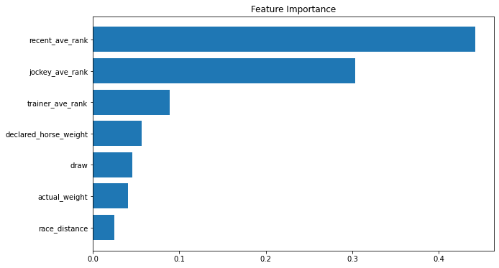
Evaluation – Feature Importance
Feature importance was done to help us
Understand the data
Improve on our model
Interpret the predictive power of the features.
The plot tells us that the performances of the horse and jockey in prior races are good predictors of whether the horse will come in first.

Slide 16
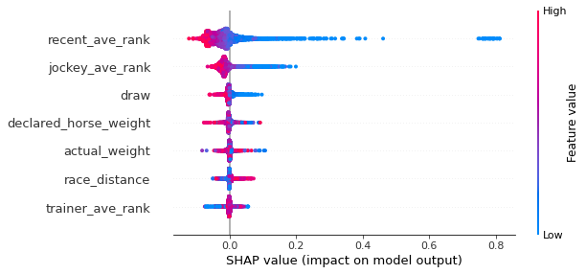
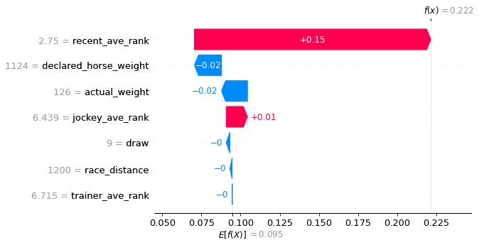
Evaluation – SHAP
The SHAP summary plot combines feature importance with feature effects.
Each point here is a Shapley value for a feature (y-axis) and an instance (x-axis)
Colour represents the value of the feature from low to high
Overlapping points are stacked in y-axis direction to give a sense of distribution
Low recent rankings of the horse and jockey (in blue) increases the predicted class of the horse winning.
The waterfall plot shows that having a recent rank of 2.75 will drastically increase the horse’s probability of winning.

Slide 17
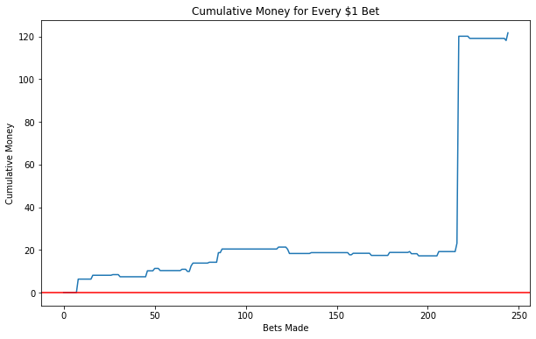
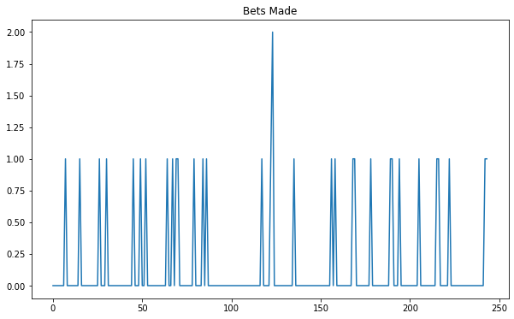
Backtesting Strategy 1 – Using Classification Prediction
We will bet $1 when our prediction returns 1 for the top horse
We get $1 x winning odds if our prediction is correct, and lose the $1 when our prediction is wrong
Ending money: $121.7
Total bets made: 33
Evaluation of results
Our model predicts 1 or 2 winners per race, but many times there are no prediction.
Our big gains come from one bet, as seen by the spike in the cumulative money plot.
Model | Money | Bets Made
SMOTE + RF | 182.3 | 339
RFC | 121.7 | 33
GNB | 9.3 | 73
LogReg | 8.9 | 13

Slide 18
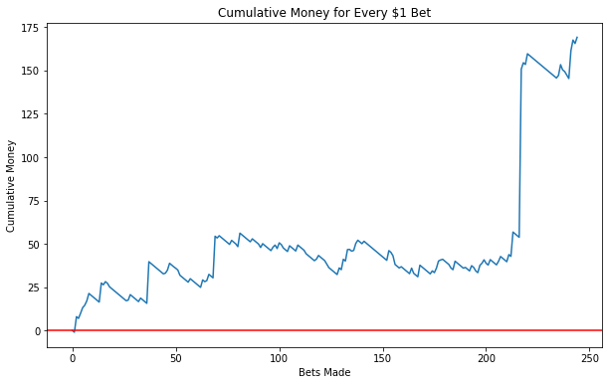
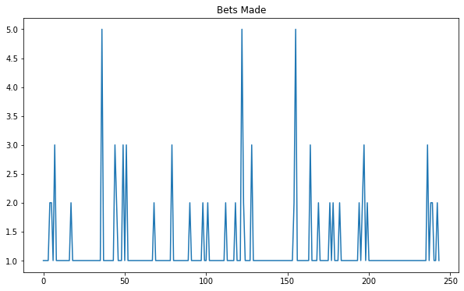
Backtesting Strategy 2 – Using Regression Prediction
We will bet $1 for the fastest horse in each race
We get $1 x winning odds if our prediction is correct, and lose the $1 when our prediction is wrong
Ending money: $169.2
Total bets made: 296
Evaluation of results
This strategy ensures that at least one bet is made every race, but sometimes the model will predict similar race timings for a few horses in a single race.
Our big gains also come from one single bet. We may also encounter long losing streaks, but luckily we did not go underwater at any stage of the backtest.
Model | Money | Bets Made
KNN | 176.1 | 244
LGBM | 169.2 | 296
Ridge | 113.1 | 244
RFR | -102.0 | 308

Slide 19
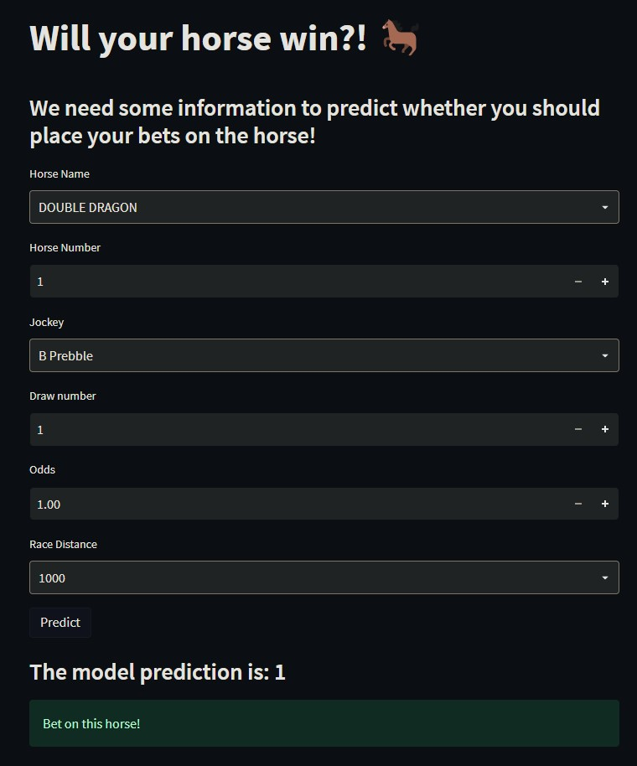
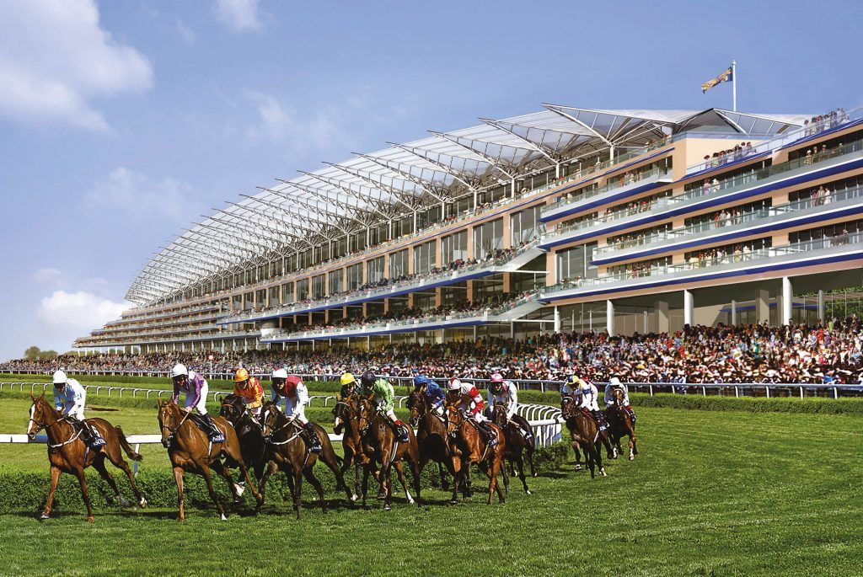

Deployment – Build a Horse Race Prediction App
Imagine you are at a horse race, and you would like to know if you should bet on a certain horse.
Horse Name: MOMENT OF POWER
Horse Number: 3
Jockey: K K Chiong
Draw Number: 3
Winning Odds: 4.0
Race Distance: 1000

Slide 20
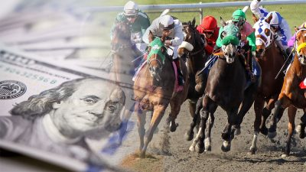
Limitations of the model
Even though the backtesting results turned out well, it remains unclear how it would fare in the real world.
All the races in the unseen set were treated as a single race, instead of separate races.
In a live app, the results and information would have to updated quickly for the model to re-train and make predictions for the next race.
Unable to make a prediction if the horse is new and has not raced before
Modelling: Should have treated a unique race as a sample, instead of just a single row
Future Improvements
To tweak and improve betting strategies
To try the model on a newer dataset to see if results still hold
Test it out live

Slide 21
Thank you!

